Slide 1
STAT 230 Final Project
May
2026
Kevin Igiehon
GDP, Health Spending, and Life Expectancy

Slide 2
Dataset Overview
Source - World Bank Open Data
Countries from all regions
Key Variables
GDP per capita
Health expenditure (% of GDP)
Life expectancy
Population

Slide 3
Question #1
Compared high vs low GDP per capita
groups
Used two-sample t-test and boxplot
Result: Higher GDP countries had greater life expectancy
Does GDP Affect Life Expectancy?

Slide 4
Used linear regression
Plotted health spending vs life expectancy
Result: Statistically significant positive relationship
Question #2
Does Health Spending Predict Life Expectancy?

Slide 5
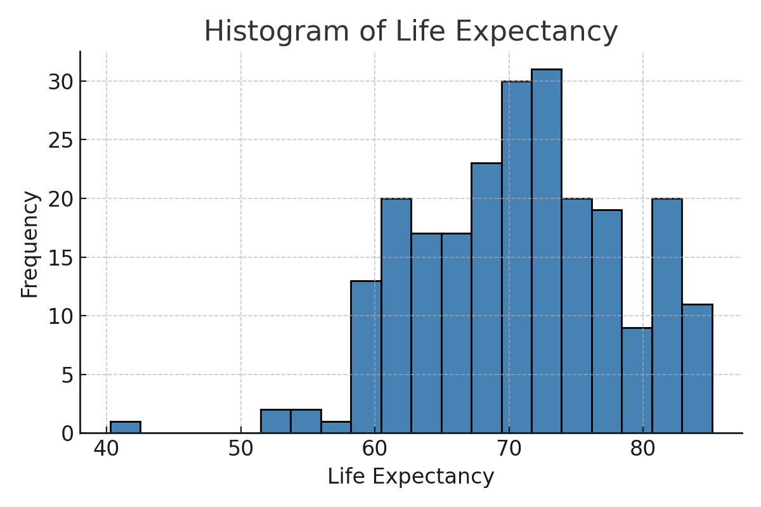
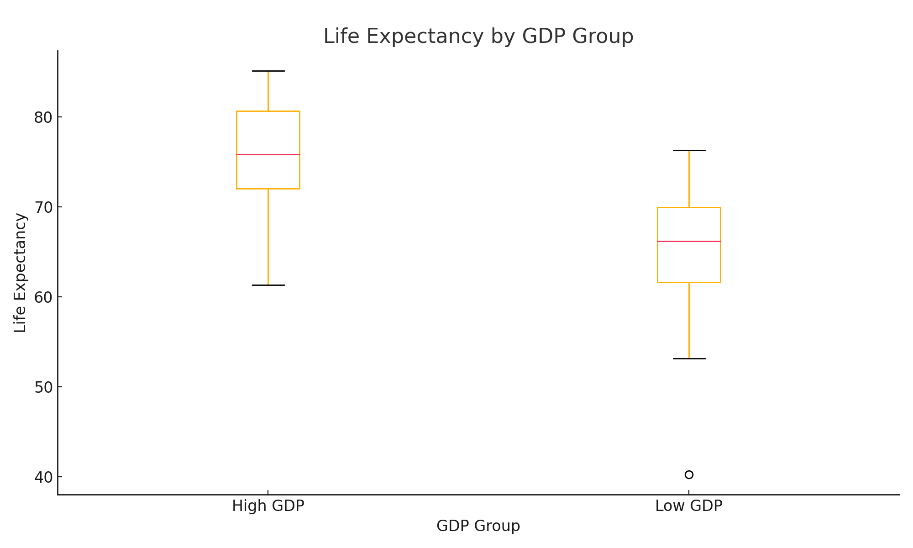
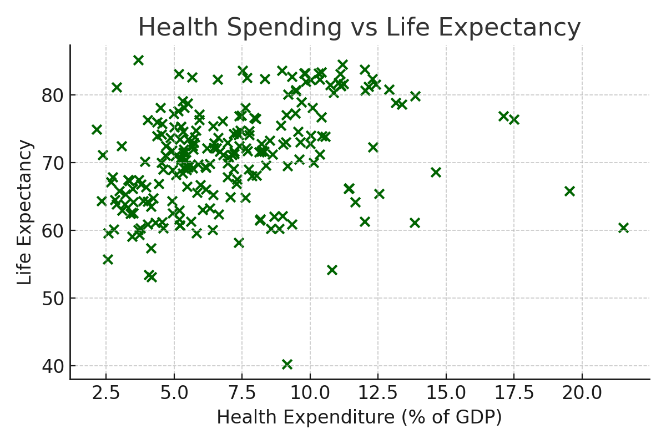
Summary of Visuals
HISTOGRAM
BOXPLOT
SCATTERPLOT

Slide 6
CONCLUSION
High GDP = longer life expectancy
Health spending is a key predictor of lifespan
Simple stats can uncover real-world insights
Bottom Line: Economic strength and investment in health save lives.
THANK YOU!

